Slide 1
Design Payment System

Slide 2
Steps
Understand the Problem and Establish Design Scope
High-level design and Get Buy-in
Design Deep Dive
Wrap Up

Slide 3
1-Understand the Problem and Establish Design Scope - chat to collect information
Payment System
Digital Wallet - Apple Pay, Google Pay, etc.
Backend System - PayPal, Square, Stripe, etc.
Payment options
Use 3rd Party payment processors
Global currencies / international payments?
Pay-in and pay-out
A payment system interacts with many internal services (accounting, analytics, etc.) and external services (payment service providers), when a service fail, we may see inconsistent states among services.
Reconciliation and fix any inconsistencies.

Slide 4
1-Understand the Problem and Establish Design Scope
Functional requirements
Pay-in flow: payment system receivers money from customers on behalf of sellers.
Pay-out flow: payment system sends money to sellers around the world.
Non-functional requirements
Reliability and fault tolerance. Failed payments need to be carefully handled;
A reconciliation process btw internal services and external services is required. It asynchronously verifies that the payment information across these services is consistent.
Traffic estimation
1M transactions /10^5 seconds = 10 transactions per second (TPS)

Slide 5
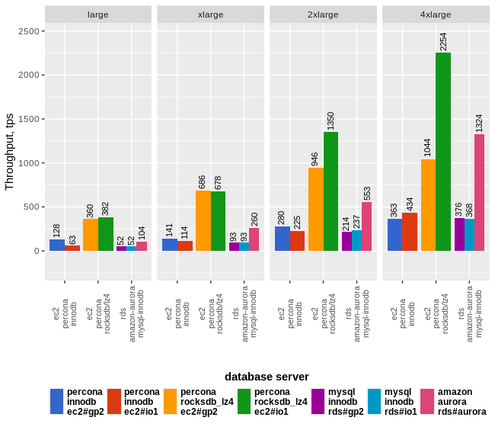
Database throughput by load tests (DB only)

Slide 6
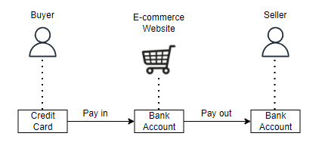
2-High-level design and Get Buy-in
Simplified pay-in and pay-out flow

Slide 7
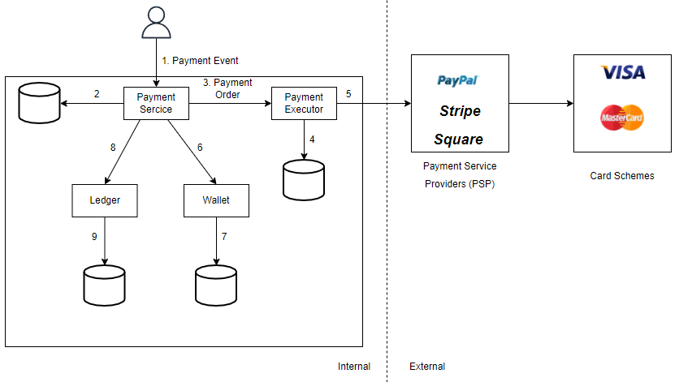
2-High-level design and Get Buy-in
Pay-in flow

Slide 8
2-High-level design and Get Buy-in - APIs for payment service
POST /v1/payments GET /v1/payments/{:id}
Field | Description | Type
buyer_info | Buyer information | json
checkout_id | A global unique ID for this checkout | string
credit_card_info | Encrypted cc info or payment token, PSP specific | json
payment_orders | A list of payment orders | list
Req params
Payment order
Field | Description | Type
seller_account | Which seller will receive the money | string
amount | The transaction amount for the order | string
currency | The currency for the order | string(ISO 4217)
payment_order_id | A global unique ID for this payment | string

Slide 9
2-High-level design and Get Buy-in - Data Model
Payment event
Payment order
Name | Type
checkout_id | string PK
buyer_info | string
seller_info | string
cc_info | depends on card provider
is_payment_done | boolean
Name | Type
payment_order_id | string PK
buyer_account | string
amount | string
currency | string
checkout_id | string FK
payment_order_status | string
ledger_updated | boolean
wallet_updated | boolean

Slide 10
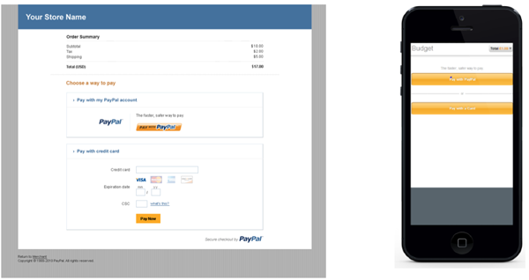
2-High-level design and Get Buy-in - Double-entry ledger system and hosted payment page
Account | Debit | Credit
buyer | $1
seller |  | $1
Avoid implementation of Payment Card Industry Data Security Standard(PCI DSS)
Sum of all the transactions = 0

Slide 11
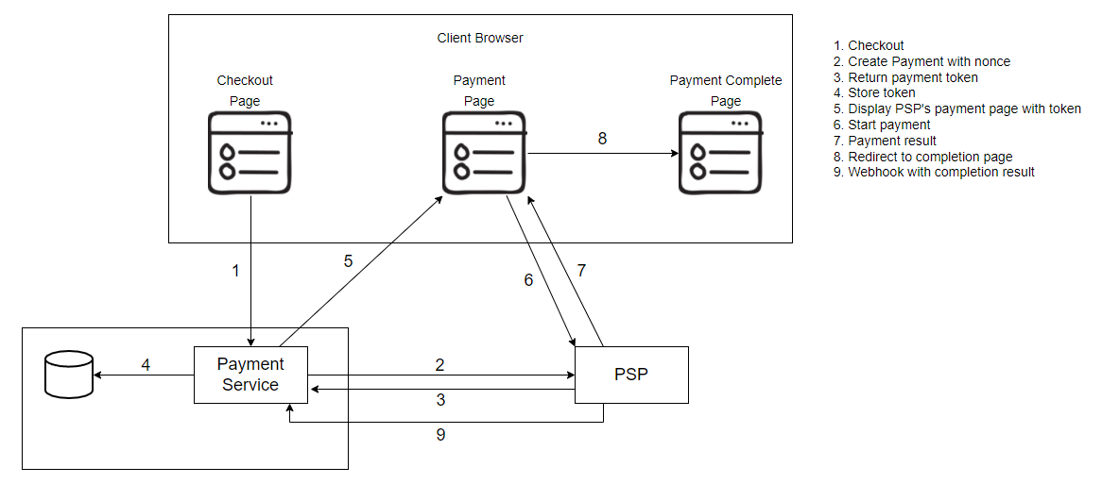
3-Design Deep Dive - PSP Integration

Slide 12
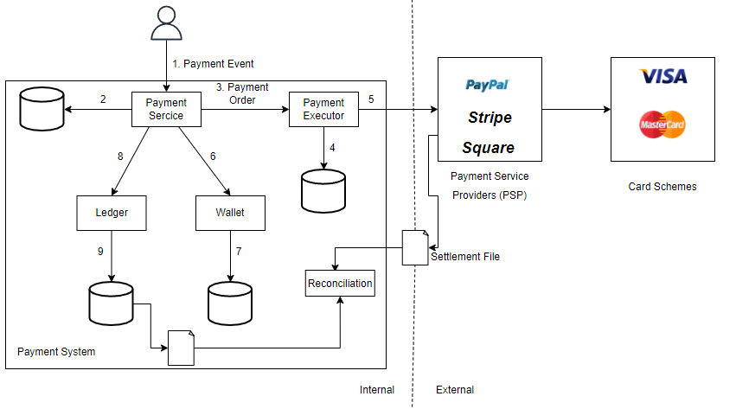
3-Design Deep Dive - Reconciliation

Slide 13
3-Design Deep Dive - Handling payment processing delays
PSP side
User side
Pending status

Slide 14
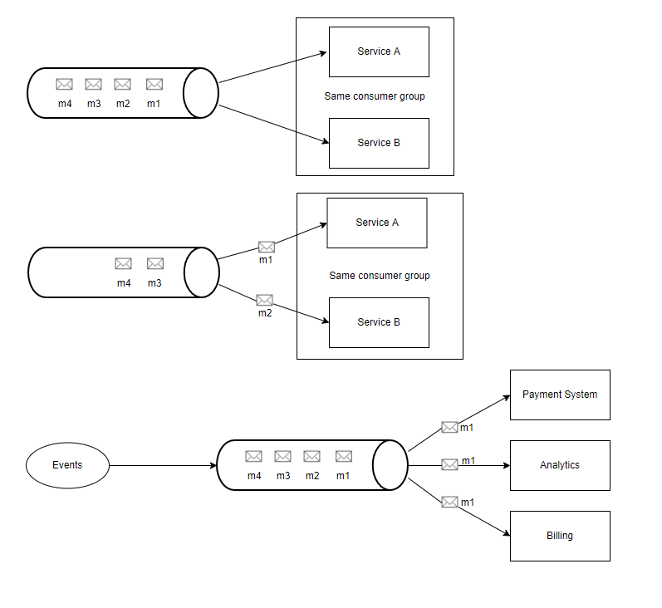
3-Design Deep Dive - Asynchronous
Synchronous communication
Asynchronous communication

Slide 15
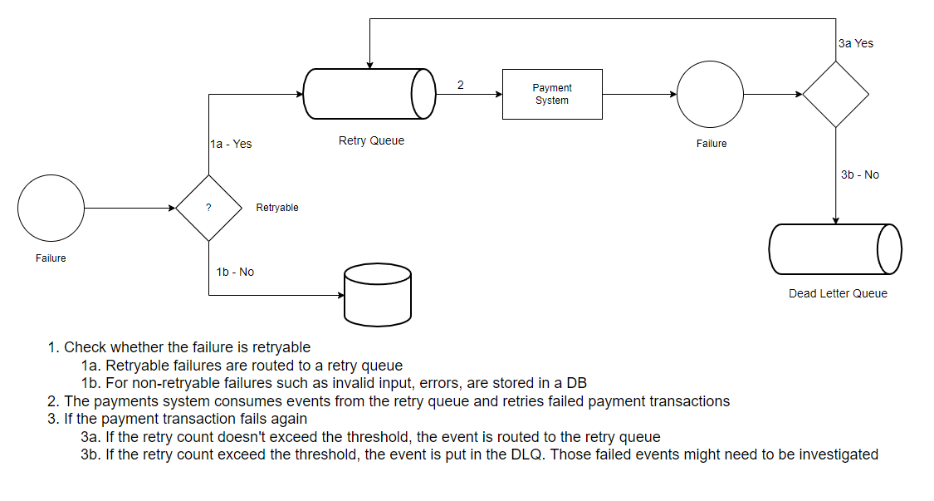
3-Design Deep Dive - Handle failed payments

Slide 16
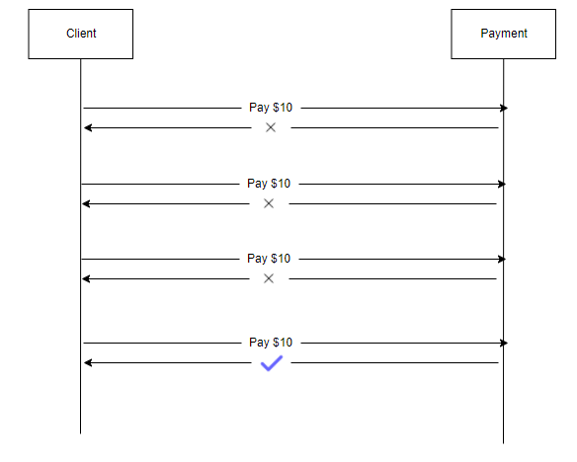
3-Design Deep Dive - Exactly-once delivery - Retry
Strategies:
Immediate retry
Fixed intervals
Incremental intervals
Exponential backoff
cancel
Potential problem - double payments

Slide 17
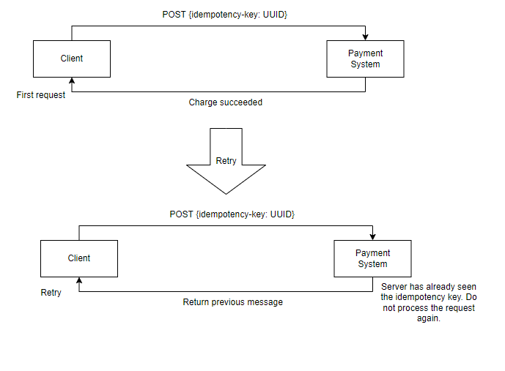
3-Design Deep Dive - Idempotency

Slide 18
3-Design Deep Dive - Consistency
The payment service keeps payment-related data such nonce, token, payment order, execution status, etc.
The ledger keeps all accounting data
The wallet keeps the account balance of the merchant
The PSP keeps the payment execution status
Data might be replicated among different data replicas to increase reliability

Slide 19
3-Design Deep Dive - Payment security
Problem | Solutions
Req/Res eavesdropping | Use HTTPS
Data tampering | Enforce encryption and integrity monitoring
Man-in-the-middle attack | Use SSL with certificate pinning
Data loss | DB replication across multiple regions and take snapshots of data
DDoS | Rate limiting and firewall
Card theft | Tokenization. Instead of using real card numbers, token are stored and used for payments
PCI implementation | PCI DSS is an infor security standard for organization that handle branded cc.
Fraud | Address verification, Card verification value(CVV), user behavior analytics, etc

Slide 20
4-Wrapping up
Pay in and pay out
Retry, idempotency, consistency
Payment error handling, security
Others:
Monitoring
Alerting
Debugging tools
Currency exchange
Geography
Cash payments (ref1, ref2)
Google / Apple pay integration (ref1)

